Slide 1

Credit Card Fraud Analytics using ml
Darshana Dahanayake
FGS/MDA/2021/030

Slide 2
What is fraud analytics?
Fraud analytics is a multidisciplinary field that combines numerous quantitative sciences in order to better understand fraud, for example through business intelligence (BI), and develop effective fraud detection solutions through data science.

Slide 3
Why fraud analytics?
Over 2000 firms reported of ~923,000 cases of suspected money laundering.
Over 1.15 million prospective customers were refused services.
A typical financial organisation loses 5% of its yearly revenue to fraud.
Estimated loss of 100 billion USD each year because of fraud.

Slide 4
How companies deal with fraud?
They use rule based trigger systems based on manually set thresholds.
Check the news.
Use ML to detect fraud or any suspicious behavior
Lookup external list of fraudsters

Slide 5
Problem Statement
Aim: Identify fraudulent credit card transaction.
The dataset contains transactions made via credit cards by european cardholders. This dataset presents transactions that occurred in two days, where we have 492 frauds out of 284,807 transactions. The dataset is highly unbalanced, the positive class (frauds) account for 0.172% of all transactions.

Slide 6
Techniques use:
Fraud Detection
Rule based trigger systems
Logistic regression
Decision trees
Random forest classifier
Neural networks

Slide 7
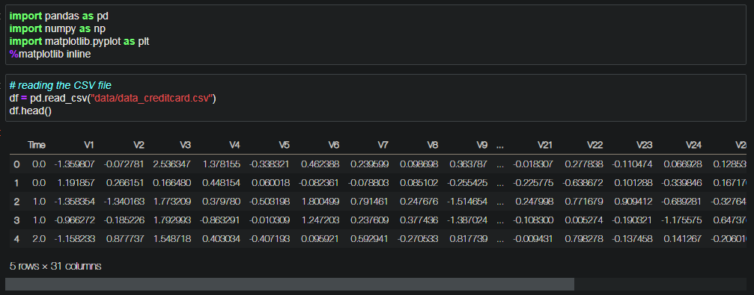
Exploratory analysis
Data
It contains only numerical input variables which are the result of a PCA transformation. Features V1, V2, ... V28 are the principal components obtained with PCA, the only features which have not been transformed with PCA are 'Time' and 'Amount’. Feature 'Time' contains the seconds elapsed between each transaction and the first transaction in the dataset. The feature 'Amount' is the transaction Amount and feature 'Class' is the response variable and it takes value 1 in case of fraud and 0 otherwise.

Slide 8
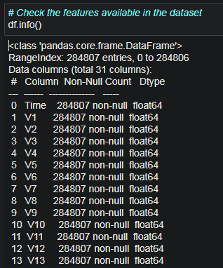
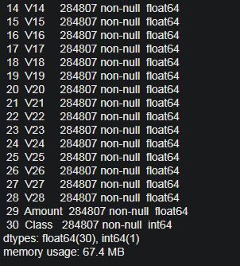
Exploratory analysis
Features available in the dataset

Slide 9
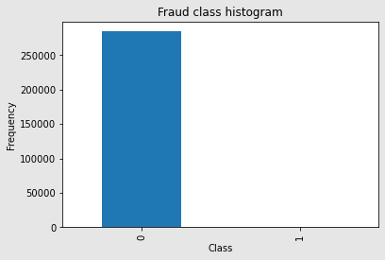
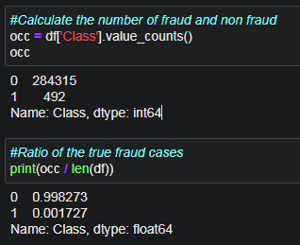
Exploratory analysis
Calculate fraud and non fraud ratio and visualization the data

Slide 10
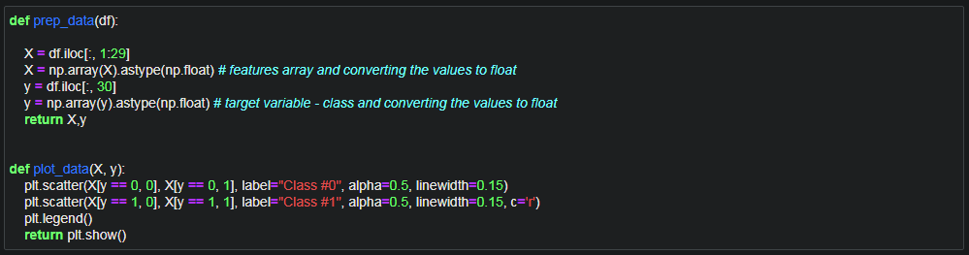
Preparing data
Separation have been done to first 29 numerical columns as feature variables. And the class column becomes the target variable which states if a transaction is legit or fraudulent. Slicing have been used to for separation

Slide 11
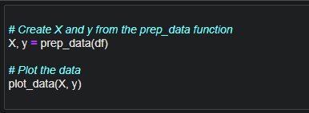
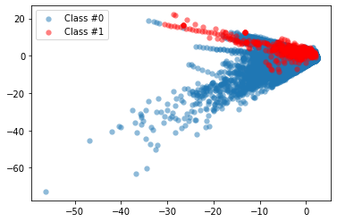
Preparing data
Plotting Class variables to check the balance of the actual fraud vs non fraudulent
After reviewing the fraudulent transactions ratio = 0.17% and graphs show the dataset is highly imbalance. Therefore imbalance data need to be resolved.

Slide 12
How to deal with highly imbalanced data?
Such highly imbalanced data can be managed with the technique call ‘resampling’. A widely adopted technique for dealing with highly unbalanced datasets is called resampling. It consists of removing samples from the majority class (under-sampling) and / or adding more examples from the minority class (over-sampling).
Popular resample techniques:
1. Random Under Sampling(RUS)
2. Random Over Sampling(ROS)
3. Synthetic Minority Oversampling Technique(SMOTE)
https://www.kaggle.com/rafjaa/resampling-strategies-for-imbalanced-datasets

Slide 13
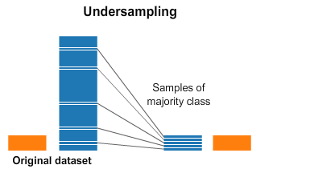
Undersampling
In under-sampling, the simplest technique involves removing random records from the majority class, which can cause loss of information.

Slide 14
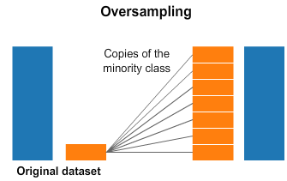
Oversampling
over-sampling is to duplicate random records from the minority class, which can cause overfitting.

Slide 15
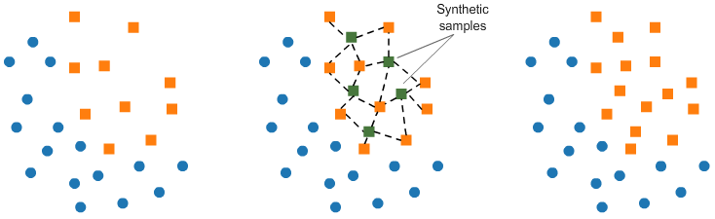
SMOTE (Synthetic Minority Oversampling TEchnique)
SMOTE (Synthetic Minority Oversampling TEchnique) consists of synthesizing elements for the minority class, based on those that already exist. It works randomly picing a point from the minority class and computing the k-nearest neighbors for this point. The synthetic points are added between the chosen point and its neighbors.

Slide 16
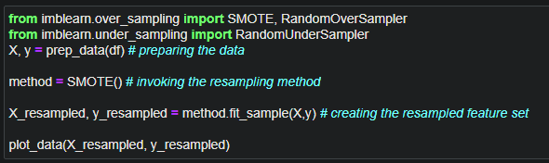
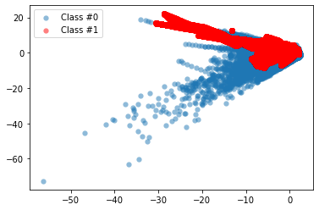
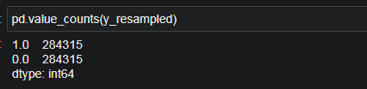
SMOTE (Synthetic Minority Oversampling TEchnique)

Slide 17
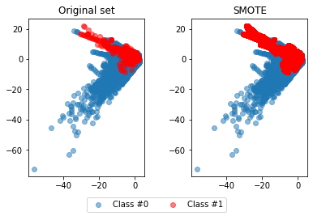
SMOTE (Synthetic Minority Oversampling TEchnique)

Slide 18
Ways to catch fraudsters
Rule-based method
ML classification algorithms:
Logistic regression
Classification algorithms

Slide 19
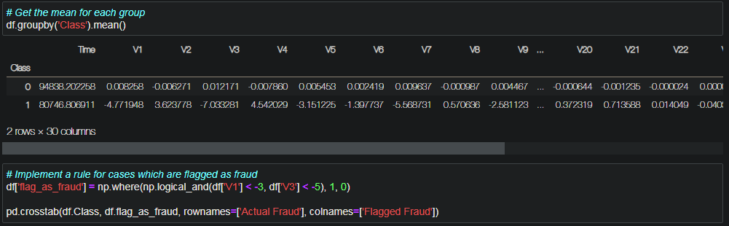
Traditional way
Use groupby() to group df on Class and obtain the mean of the features. Define the thresholds/rules like, V1 smaller than -3, and V3 smaller than -5 as a condition to flag fraud cases. As a measure of performance, use the confusion matrix compare our flagged fraud cases to actual fraud cases.

Slide 20
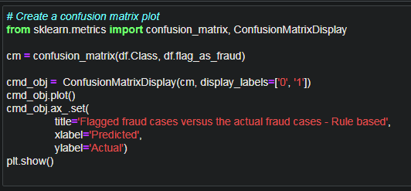
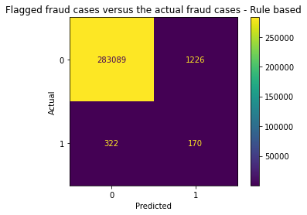
Traditional way
Measuring the ‘Old way’ analysis

Slide 21
Traditional way
Measuring the ‘Old way’ analysis

Slide 22
Classification methods
1. Logistic regression
2. Decision trees
3. Random forests
4. Neural networks

Slide 23
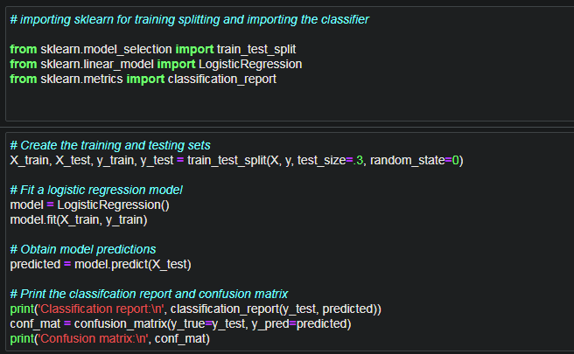
Logistic regression

Slide 24
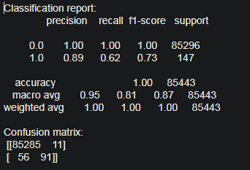
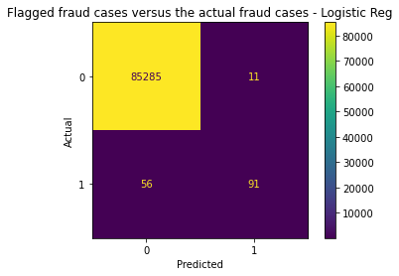
Logistic regression
Getting much less false positives, so that's an improvement. Also, noticed catching a higher percentage of fraud cases, so that is also better than before. Above performance based on test data

Slide 25
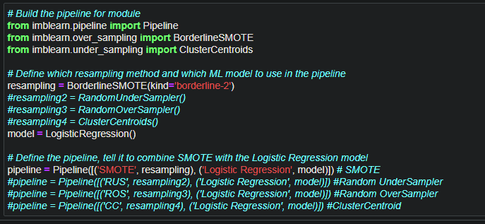
Logistic regression combined with SMOTE & pipeline

Slide 26
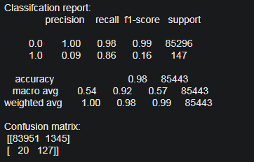
Logistic regression combined with SMOTE & pipeline

Slide 27
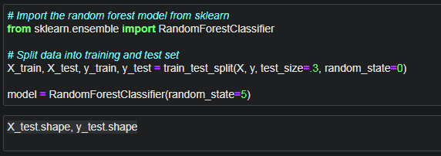
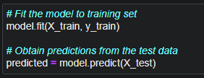
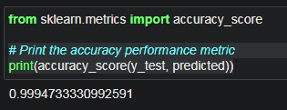
Random forest classifier

Slide 28
Random forest classifier

Slide 29
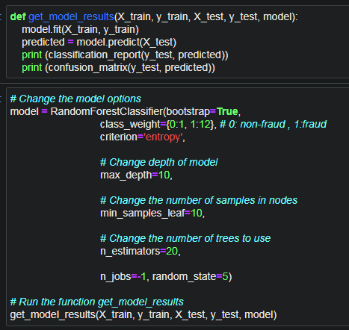
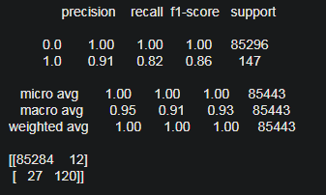
Random forest classifier optimized hyperparameters
Adjusting the RFC to fraud detection

Slide 30
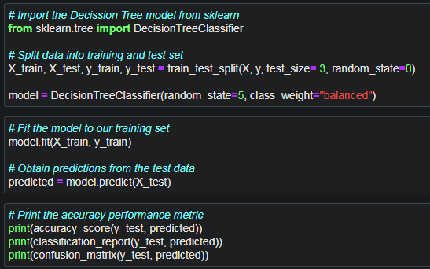
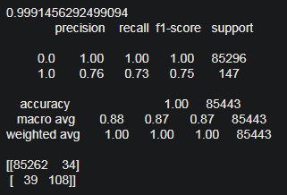
Decision Tree Classifier

Slide 31
Thank You

